Slide 1


File Handling
With Python
By: Ayush Vora
North Park Hack Club

Slide 2
01
03
05
About File Handling
Reading Files
Challenge
02
04
Opening Files
Writing Files

Slide 3
01
About File Handling
What is it and how can you use it?

Slide 4
About File Handling
What is it?
Which Files?
Why Use It?
Where are they Stored?
When is it Used?
Specifically What?
File Handling is the creation, modification, and deletion of files
They can edit most types of files, but the most common is .txt
Files are stored permanently unlike Python variables
Files are saved to the hard-drive while Python variables are saved to RAM
Many different uses; most commonly in web applications
Well…

Slide 5
Some Uses for File Handling
Simple Database
Store User Info
Keep High Scores
Writing a Story?
Used to store information about the project
Avoid signing again with a simple cache
High Scores shouldn’t reset after closing a program
I mean you can if you want…

Slide 6
02
Opening Files
Time to start coding!

Slide 7
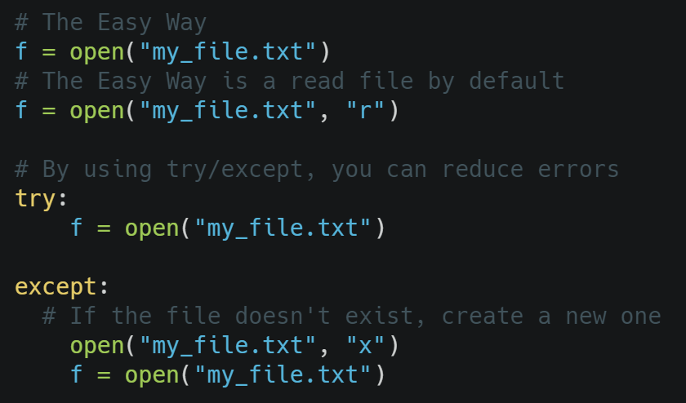
Opening Files
By opening a file, you can interact with the file within your code
Takes two parameters:
File name
Optional Parameters
“r” – Read
“a” – Append
“w” – Write
“x” – Create
After opening a file, close it.

Slide 8
03
Reading Files
Use Content in the File in a Python Script

Slide 9
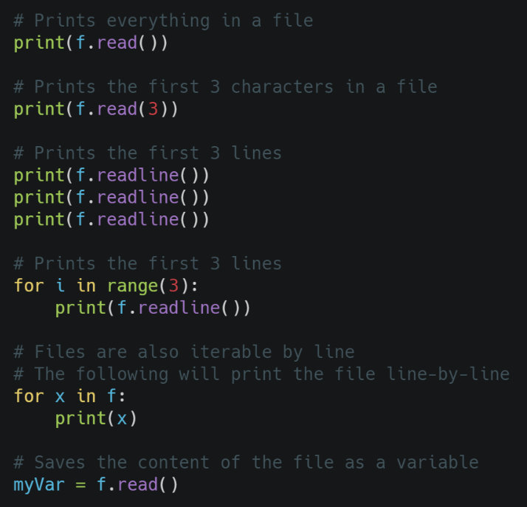
Reading Files
By reading files, you can use content in a file in your own Python Script or Program
The read() function simply reads the content of the file
The readline() function reads the next line
Every line in a file is iterable
Content can also be saved to a variable

Slide 10
04
Writing Files
Add content to your file

Slide 11
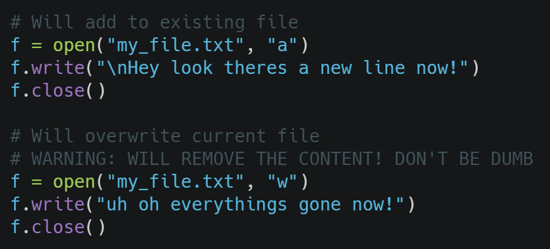
Writing Files
Writing files allows you to modify the file depending on your needs
Adding the “a” parameter will ADD text to the file (append)
Adding the “w” parameter will REPLACE (write)
Always close the file after opening it!

Slide 12
Example Time
High Score

Slide 13
Challenge Time!

